Slide 1

Bitcoin Price Prediction Using K-Means Clustering
This project focuses on Bitcoin price prediction using K-Means clustering and hyperparameter tuning. The aim is to enhance market trend analysis for various sectors such as finance, trading, and investment management. K-Means clustering is utilized to identify patterns in Bitcoin price movements based on historical data.
The model is trained on historical Bitcoin price data, incorporating features like opening price, closing price, trading volume, and market trends. By leveraging machine learning, this approach improves traditional market analysis methods, offering valuable insights for real-world decision-making.

Slide 2

Objectives of Bitcoin Price Prediction
1
Bitcoin Price Trend Analysis
2
Data Preprocessing and Feature Selection
Analyze historical Bitcoin price data and identify distinct price patterns using K-Means clustering to help investors and traders make informed decisions.
Select relevant features (opening price, closing price, trading volume, market trends) from historical Bitcoin data to ensure effective clustering and improve model accuracy.
3
Model Development and Evaluation
Design and implement a K-Means clustering model that groups Bitcoin price trends and evaluate its performance using metrics such as Inertia, Silhouette Score, and Davies-Bouldin Index.

Slide 3
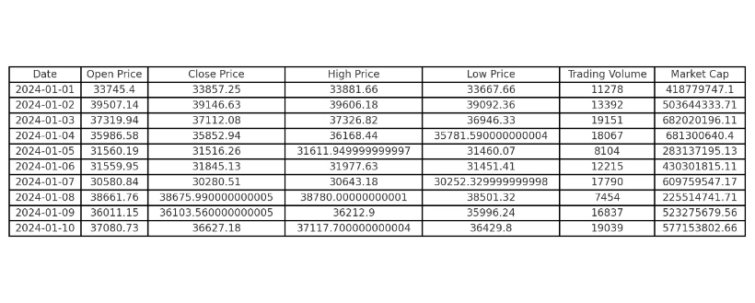
Dataset Overview
Key Variables
Date: YYYY-MM-DD format
Open Price: Price at trading day start
Close Price: Final price at trading day end
High Price: Highest price during the day
Low Price: Lowest price during the day
Trading Volume: Total Bitcoin traded
Market Cap: Total market capitalization
The dataset used for this project contains historical Bitcoin price data, which includes essential financial indicators. These variables are crucial for understanding and predicting Bitcoin price movements.

Slide 4




K-Means Clustering Algorithm
Cluster Structure
Each cluster is defined by a centroid, representing the average of all points. Data points are assigned to the nearest centroid based on a distance metric.
How it Works
The algorithm selects K random centroids, assigns each data point, recalculates centroids, and repeats until clusters are stable.
Choosing Optimal Clusters
The Elbow Method, Silhouette Score, and Davies-Bouldin Index are used to determine the optimal K value for clustering.
K-Means clustering is a widely used unsupervised machine learning algorithm for grouping data points into clusters based on similarity. It is used for various applications, including Bitcoin price prediction, where it helps identify trends and patterns in historical price data.

Slide 5




Methodology for Bitcoin Price Prediction
Data Collection and Preparation
Collect historical Bitcoin price data, including date, open price, close price, high price, low price, trading volume, and market cap.
Data Preprocessing
Handle missing values, normalize or scale the data, convert the date column into a numerical format, and remove outliers.
K-Means Clustering Model
Determine the optimal number of clusters (K) using the Elbow Method or Silhouette Score. Split the dataset into training and testing sets.

Slide 6
Implementation Steps
Import Libraries
Load the Dataset
Import necessary Python libraries such as pandas, numpy, scikit-learn, and matplotlib.
Load the historical Bitcoin price data from a CSV file into a pandas DataFrame.
Data Preprocessing
Clean and preprocess the data by handling missing values, scaling features, and converting date formats.
To implement a K-Means Clustering algorithm for Bitcoin Price Prediction using Python, we will leverage some python libraries. Below are the key steps involved in this process: Importing Libraries, loading data, preprocessing, training the model, making predictions, evaluating performance, and visualizing results.

Slide 7
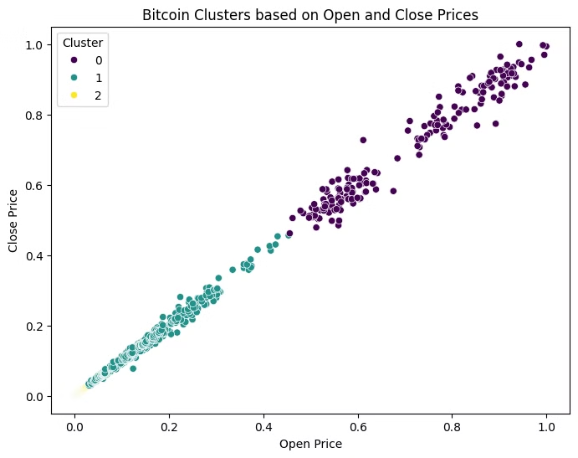
Visualizing Clusters
We visualize clusters using a scatter plot of Open vs. Close prices. The scatter plot shows the distribution of Bitcoin price data points across different clusters. Each cluster represents a distinct pattern or trend in Bitcoin price movements.
The visualization helps in understanding how the K-Means clustering algorithm has grouped similar price behaviors together. Different colors or markers can be used to distinguish between clusters, making it easier to interpret the results.

Slide 8




Model Evaluation Techniques
Inertia
Silhouette Score
Measures how tightly data points are clustered. Lower values indicate more compact clusters.
1
2
Evaluates how well each data point fits its assigned cluster. Values close to 1 indicate well-separated clusters.
Elbow Method
Davies-Bouldin Index
Helps determine the ideal number of clusters (K) by plotting WCSS against different K values.
Assesses cluster compactness and separation. Lower values indicate well-separated clusters.
4
3
Evaluating the performance of a K-Means Clustering model for Bitcoin price prediction is essential to determine how well the clustering algorithm groups similar price patterns and trends. Unlike supervised learning models, K-Means does not have traditional classification metrics like accuracy or precision. Instead, we use clustering-specific evaluation metrics.

Slide 9

Conclusion
Valuable Insights
K-Means Clustering provides valuable insights into market trends by identifying distinct price patterns and behaviors.
Effective Technique
Serves as an effective unsupervised learning technique for analyzing Bitcoin price movements.
Data-Driven Approach
Offers a data-driven approach that can assist investors in making better financial decisions.
The application of K-Means Clustering in Bitcoin price prediction has provided valuable insights into market trends by identifying distinct price patterns and behaviors. The ability of K-Means to group similar data points based on historical price fluctuations enables traders and analysts to recognize market cycles, detect anomalies, and make informed investment decisions.

